Slide 1
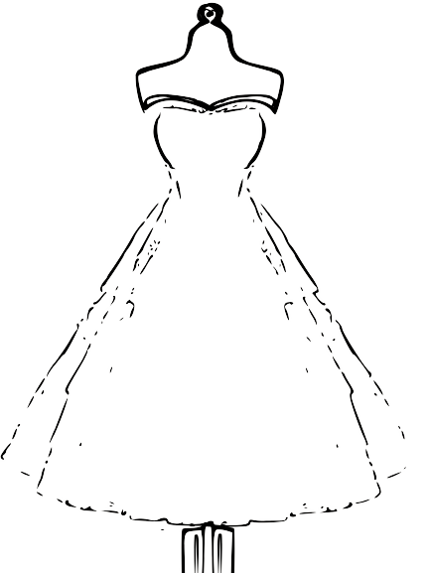
Dress by DESs
Danielle Paton, Eila Markandey, Sarina Saran, and Sapna Chokshi

Slide 2
OUR PROJECT
Dress by Dess is a website designed to fit your daily fashion needs according to the weather.
Just input your location, chosen occasion, and you're done! The perfect, weather appropriate outfit is generated.

Slide 3
PURPOSE OF DRESS BY DESS
The mornings are already stressful, and choosing an outfit adds onto it. Instead of wasting time trying on multiple outfits, Dress By Dress helps quicken this process by lifting the stress off your shoulders.

Slide 4
PROCESS
USER
IMPLEMENTER
Access the API
Get specific weather condition
Use occasion to choose an outfit
Send the outfit to the website
Connected the Python file to Bootstrap HTML file using Flask.
Using HTML and CSS, we created a website that included the following:
Question asking for location
Display weather condition
Select occasion
Display generated outfit
Start Over

Slide 5
User experience
DRESS BY DESS
How we incorporated user
experience into our project

Slide 6



WEATHER TRENDS
DRESS BY DESS
After entering a location, the current weather conditions of that city is displayed. Considering the weather and chosen occasion, an outfit is generated appropriately.

Slide 7

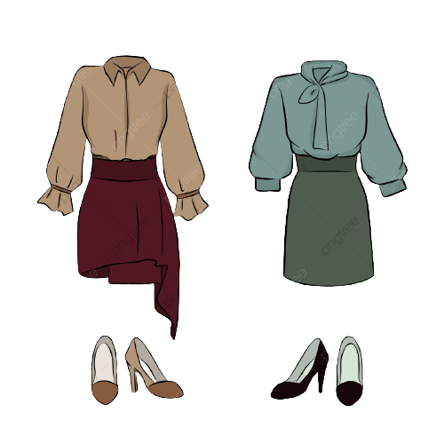
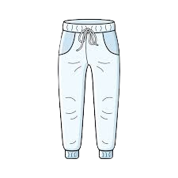
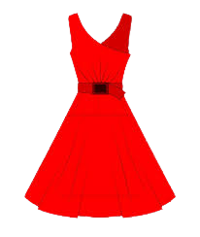
OCCASION OPTIONS
Athletic/Leisure
Professional
Athletic tops, Workout set, Windbreaker, Running shoes
Suit, Blazer, Flats
Casual
Fancy
Sweater, Jeans, corduroy Jacket, Booties
Dress, Long skirt, Trench coat, Heels

Slide 8



ACCESSORIES
WEATHER BASED
Earmuffs, Gloves, Scarves, Sunglasses
HATS
BAGS
Warm hat, Baseball cap
Tote bag, Fanny pack, Belt bag, Purse

Slide 9
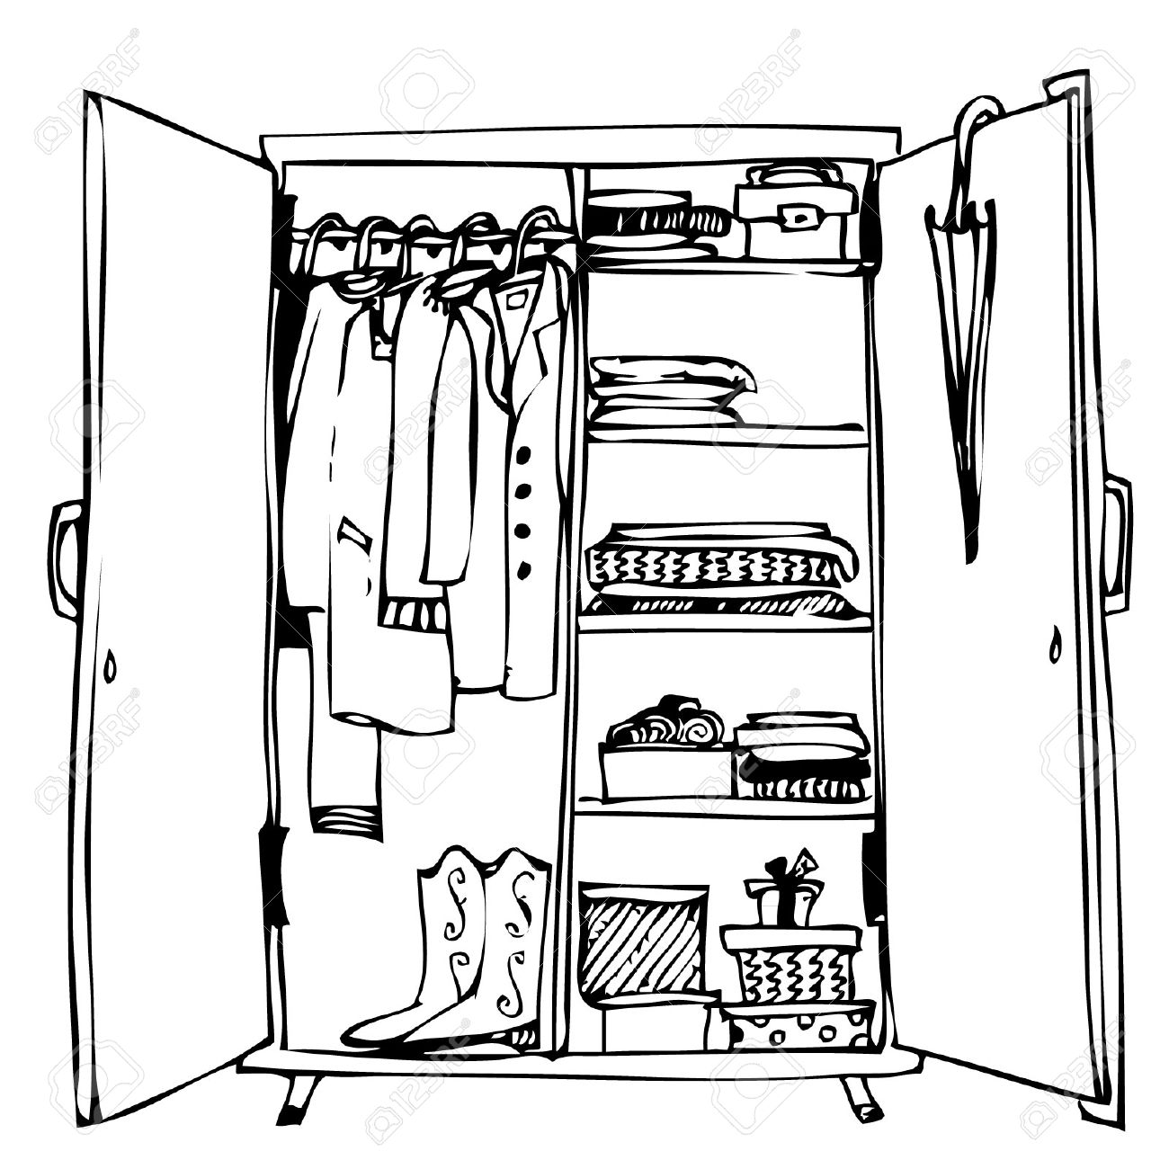
YOUR FASHION JOURNEY AWAITS!

